Slide 1
Lecture 6 Intro to search (solving problems by search)
CS 180 – Intelligent Systems
Dr. Victor Chen
Fall 2022

Slide 2
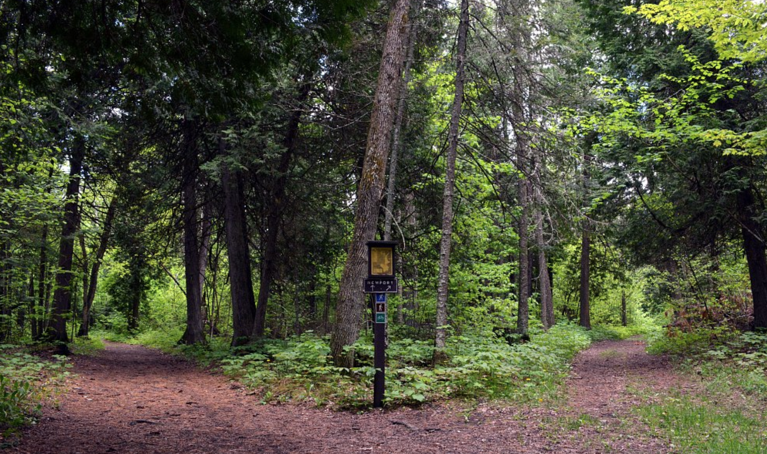
Solving problems by search

Slide 3

Review: PEAS model: on which most of AI agents work
PEAS: Performance measure, Environment states, Actuators, Sensors
P: a function the agent is maximizing (or minimizing)
E: A state = a group of variables
A: actions that the agent takes to move from one state to another according to a transition model
S: observations/sensors that allow the agent to infer the state

Slide 4

Maze problems
Initial
state
Initial state
Actions
Goal state
Objective function
Shortest path (a sum of step costs)
from the initial state to a goal state
Goal state

Slide 5
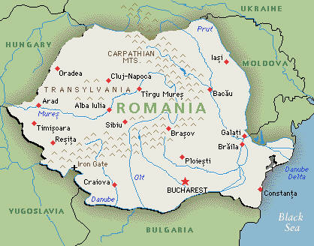
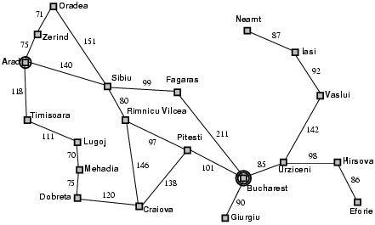
Example: Romania Traveling
On vacation in Romania; currently in Arad
Flight leaves tomorrow from Bucharest
The optimal solution is the shortest path from Arad to Bucharest
Initial state
Arad
Actions
Go from one city to another
Goal state
Bucharest
Objective function
Minimax the sum of edge costs (total distance traveled)

Slide 6
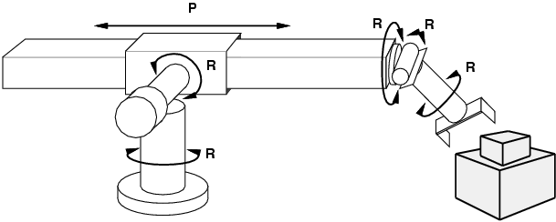
Example: Robot motion planning
States
Real-valued robot joint parameters (angles, displacements)
Actions
Continuous motions of robot joints
Goal state
Configuration in which object is grasped
Path cost
Time to execute, smoothness of path, etc.

Slide 7
State space
Given an AI problem, state space refers to all the states reachable from initial state
How large the state space can be?

Slide 8
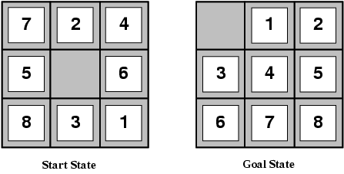
Example: The 8-puzzle
3x3 board with 8 tiles. Each tile represents a number
A tile can only slide into the blank space .
States
Locations of tiles
8-puzzle: 181,440 states (9!/2)
15-puzzle: ~10 trillion states
24-puzzle: ~10²⁵ states
Actions
Move blank space left, right, up, down
Path cost
Each step costs 1.

Slide 9
What is Search?
Given:
Initial state
Goal state
Actions
Transition model
Path cost function
find a sequence of actions that minimize the cost
Can we use Dijkstra’s shortest path algorithm?
Cost of Dijkstra’s is O(E + V log V), where V is the size of the state space
Unaffordable cost because V may be huge!

Slide 10
Search: Basic idea
Begin at the initial state and expand it to all possible successor states
Maintain a frontier (a list of unexpanded states)
At each step, pick a state from the frontier to expand
Keep going until you reach a goal state
Goal: Try to expand as few states as possible

Slide 11
Search: Basic idea
start

Slide 12
Search: Basic idea

Slide 13
Search: Basic idea

Slide 14
Search: Basic idea

Slide 15
Search: Basic idea

Slide 16
Search: Basic idea

Slide 17
Search: Basic idea

Slide 18
Search: Basic idea

Slide 19
Search: Basic idea

Slide 20
Search: Basic idea

Slide 21
Search: Basic idea

Slide 22
Search: Basic idea

Slide 23
Search: Basic idea
All search algorithms share the basic idea above; they vary according to which state we will pick from the frontier to expand next (the so-called search strategy )

Slide 24
Pseudocode of All Search Algorithm
1. Initialize the frontier using the initial state
2. While the frontier != empty
Choose a frontier node according to search strategy and take it off the frontier
If the node is goal state, return solution
Else expand the node and add its successor states to the frontier

Slide 25
Visualization by Search tree
We can build a search tree for whole process, where each nodes represents a state
The root node is the initial state
The children of a node are the successor states of that node
A path corresponds to a sequence of actions
Goal: Find a path ending in the goal state
Starting state
Action
Successor state
…
Frontier
Goal state

Slide 26
Two ways to show a search process:
State Space Graphs vs. Search Trees
State Space Graph
Search Tree
S
Each NODE in search tree is a PATH in state space graph.
a
G
d
e
p
b
c
q
b
c
e
h
r
d
e
f
a
a
h
r
p
q
f
S
h
p
q
f
q
c
G
p
q
r
q
c
G
a
a

Slide 27

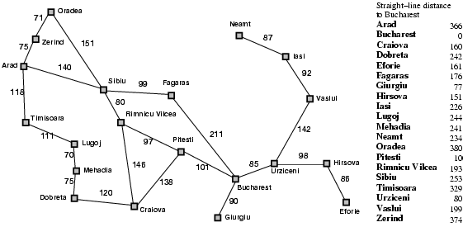
Tree search example (Romania)
Start: Arad
Goal: Bucharest

Slide 28
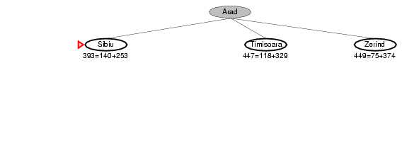
Tree search example
Start: Arad
Goal: Bucharest

Slide 29
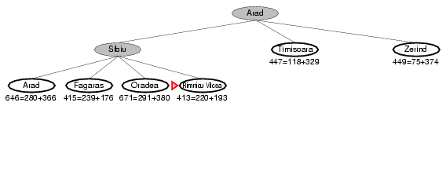
Tree search example
Start: Arad
Goal: Bucharest

Slide 30
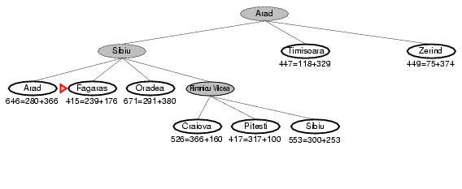
Tree search example
Start: Arad
Goal: Bucharest

Slide 31
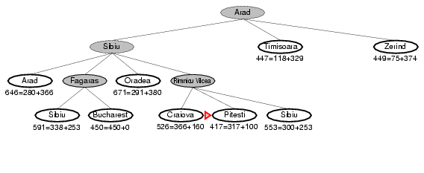
Tree search example
Start: Arad
Goal: Bucharest

Slide 32
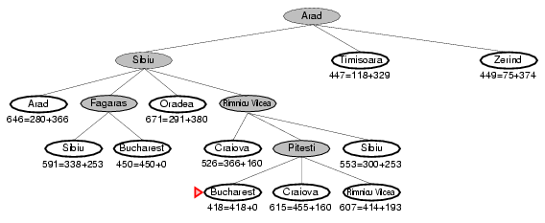
Tree search example
Start: Arad
Goal: Bucharest

Slide 33
Tree search example
Start: Arad
Goal: Bucharest
Notes:
This search tree is infinitely deep, contains redundant paths

Slide 34
Improve the search above by handling repeated states
In the example above, when we expand the node, we add all its successor states to the frontier
In order to eliminate repeated states:
Every time you expand a node, add that node to a explored set; do not add any explored states to the frontier again
Every time you add a node to the frontier, check if it already exists in the frontier with a higher path cost, and if yes, replace that node with the new one

Slide 35
Search without repeated states
Start: Arad
Goal: Bucharest

Slide 36
Search without repeated states
140
118
75
Start: Arad
Goal: Bucharest

Slide 37
Search without repeated states
118
75
280
239
291
220
Start: Arad
Goal: Bucharest

Slide 38
Search without repeated states
118
75
280
239
291
366
317
300
Start: Arad
Goal: Bucharest

Slide 39
Search without repeated states
118
75
280
291
338
450
366
317
300
Start: Arad
Goal: Bucharest

Slide 40
Search without repeated states
118
75
280
291
338
450
366
300
418
455
414
Start: Arad
Goal: Bucharest

Slide 41
Search without repeated states
118
75
280
291
338
450
366
300
418
455
414
Start: Arad
Goal: Bucharest

Slide 42
Analysis of search strategies
All the search algorithms we will learn follow the idea above.
In the following two lectures, we will examine search performance using the following criteria:
Completeness: does it always find a solution if one exists?
Optimality: does it always find a least-cost solution?
Time complexity: maximum number of nodes expanded
Space complexity: maximum number of nodes kept in memory
Time and space cost are measured in terms of
b: maximum branching factor of the search tree
d: depth of the optimal solution
m: the depth of the entire search tree

